Slide 1


FA C I A L R E C O G N I T I O N AT T E N DA N C E S Y S T E M
R A V I K U M A R
9 9 2 2 0 0 4 0 1 8 1
B - T E C H ( C S E )
MICRO PROJECT

Slide 2


AGENDA
Introduction
About software Tool Usage of Tool Reported Literature Objective of project
Timeline of work proposal Used Algorithm
Work done in step by step description Results and Discussion Summary
References.

Slide 3


INTRODUCTION
DEFINITION: Facial recognition is a biometric technology that identifies or verifies individuals by analyzing patterns based on the person's facial contours.
IMPORTANCE: It plays a crucial role in security, identification, and access control.
APPLICATIONS: Facial recognition is used in various sectors including law enforcement, banking, retail, and attendance management.

Slide 4
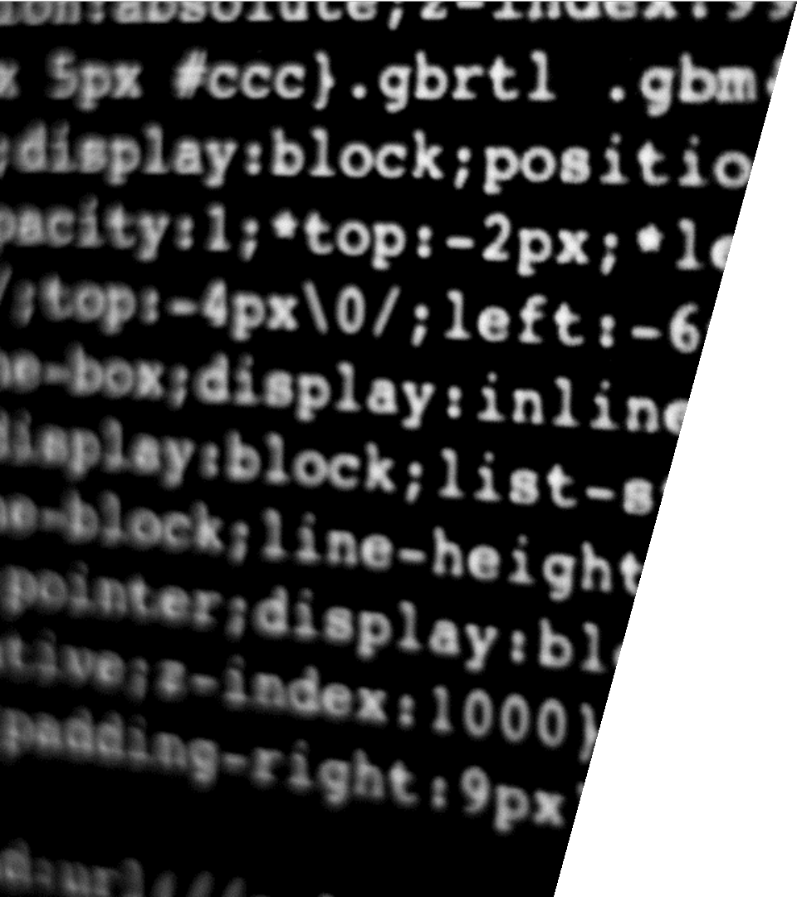
A B O U T S O F T W A R E T O O L
O P E N C V : open - s o u r c e c o m p u t e r v i s i o n l i b r a r y w i t h e x t e n s i v e f a c i a l r e c o g n i t i o n c a p a b i l i t i e s .
D L I B : c + + l i b r a r y o f f e r i n g f a c i a l d e t e c t i o n , a l i g n m e n t , a n d r e c o g n i t i o n a l g o r i t h m s .
A M A Z O N R E K O G N I T I O N : c l o u d - b a s e d s e r v i c e
p r o v i d i n g f a c i a l a n a l y s i s a n d r e c o g n i t i o n f e a t u r e s
w i t h h i g h s c a l a b i l i t y.
M I C R O S O F T A Z U R E F A C E A P I : c l o u d - b a s e d f a c i a l r e c o g n i t i o n s e r v i c e o f f e r i n g d e t e c t i o n , v e r i f i c a t i o n , a n d i d e n t i f i c a t i o n c a p a b i l i t i e s .
F A C E + + : ai - p o w e r e d f a c i a l r e c o g n i t i o n p l a t f o r m p r o v i d i n g c o m p r e h e n s i v e f a c i a l a n a l y s i s a n d
r e c o g n i t i o n s o l u t i o n s .

Slide 5

U S A G E OF T O O L
I m p o r t i n g R e q u i r e d L i b r a r i e s : T h e s c r i p t i m p o r t s n e c e s s a r y
l i b r a r i e s s u c h a s f a c e _ r e c o g n i t i o n , c v 2 ( O p e n C V ) , n u m p y , c s v ,
a n d d a t e t i m e .
L o a d i n g K n o w n F a c e s : I m a g e s o f k n o w n i n d i v i d u a l s ( s t u d e n t s i n t h i s c a s e ) a r e l o a d e d u s i n g
f a c e _ r e c o g n i t i o n . l o a d _ i m a g e _ f i l e ( ) f u n c t i o n . T h e i r f a c i a l
e n c o d i n g s a r e c o m p u t e d u s i n g
f a c e _ r e c o g n i t i o n . f a c e _ e n c o d i n g s ( ) f u n c t i o n .
I n i t i a l i z i n g V a r i a b l e s : K n o w n f a c e e n c o d i n g s a n d
c o r r e s p o n d i n g n a m e s a r e s t o r e d i n l i s t s . A l s o , a l i s t o f e x p e c t e d s t u d e n t s i s c r e a t e d .
C a p t u r i n g V i d e o : T h e s c r i p t c a p t u r e s v i d e o f r o m t h e d e f a u l t c a m e r a u s i n g O p e n C V ' s V i d e o C a p t u r e c l a s s .
F a c e R e c o g n i t i o n L o o p : I n s i d e t h e m a i n l o o p ( w h i l e T r u e ) , t h e s c r i p t c o n t i n u o u s l y c a p t u r e s f r a m e s f r o m t h e v i d e o f e e d a n d p r o c e s s e s t h e m .
F a c e R e c o g n i t i o n : I t d e t e c t s f a c e s i n t h e c a p t u r e d f r a m e u s i n g f a c e _ r e c o g n i t i o n . f a c e _ l o c a t i o n s ( ) a n d c o m p u t e s
e n c o d i n g s u s i n g f a c e _ r e c o g n i t i o n . f a c e _ e n c o d i n g s ().

Slide 6

Re por te d l i te rature i n fa c i a l
re cognition se r ve s a s A foundation for the deve l opme nt and improve me nt of fa c i a l re cognition syste m s .
R E P O R T E D L I T E R A T U R E
By a ddre s s i ng a l gor i thm i c c ha l l e nge s , evaluating pe r for manc e , addre s s i ng
pr i va c y conc e r ns, a nd ex p l or i ng
a pplication sc e na r i os, re se a rc he rs contr i bute to the a dva nc e m e nt a nd re sponsible de p l oy me nt of fac i a l
re cognition te c hnology.

Slide 7
K e y G o a l s :
A u t o m a t e d A t t e n d a n c e Tr a c k i n g
O B J E C T I V E OF P R O J E C T
A c c u r a c y a n d Ef f i c i e n c y R e a l - T i m e M o n i t o r i n g
C o n v e n i e n c e f o r U s e r s a n d A d m i n i s t r a t o r s I n t e g r a t i o n a n d S c a l a b i l i t y
S e c u r i t y a n d P r i v a c y
B e n e f i t s :
S t r e a m l i n e d a t t e n d a n c e p r o c e s s H i g h a c c u r a c y a n d e f f i c i e n c y
R e a l - t i m e m o n i t o r i n g
C o n v e n i e n c e f o r u s e r s a n d a d m i n i s t r a t o r s I n t e g r a t i o n w i t h e x i s t i n g s y s t e m s
S c a l a b i l i t y f o r v a r y i n g u s e r a n d l o c a t i o n n e e d s
E n h a n c e d s e c u r i t y a n d p r i v a c y m e a s u r e s

Slide 8
TIMELINE OF WORK PROPOSAL
Week 1: Planning and Preparation
Define project scope, objectives, and key stakeholders.
Conduct initial research on facial recognition technology and attendance systems.
Identify hardware and software requirements. Assign roles and responsibilities to team members. Week 2: Development and Testing
Develop facial recognition algorithms.
Implement attendance tracking logic. Integrate system components.
Conduct initial testing and debugging to ensure functionality.
Week 3: Deployment and Training
Deploy the system in pilot locations.
Train users and administrators on system usage. Gather feedback and make necessary adjustments. Conduct final testing and quality assurance checks.

Slide 9
Imports: The necessary libraries are imported, including face_recognition, cv2, numpy, csv, and datetime.
Video Capture Setup: The code initializes a video capture object from the default camera (VideoCapture(0)).
Loading Known Faces: Images of known individuals are loaded using face_recognition.load_image_file() and their facial encodings are computed using face_recognition.face_encodings(). These encodings are stored along with the corresponding names in known_face_encodings and known_face_names, respectively.
Main Loop: The code enters a loop where it continuously captures frames from the video feed.
Face Recognition: For each frame, faces are detected and their encodings are computed. The face_recognition.compare_faces() function is used to compare the computed encodings with the known encodings to determine if a match is found.
Attendance Logging: If a match is found, the name of the recognized individual is retrieved. If the recognized individual is among the list of expected students, their name and the current time are logged into a CSV file named with the current date.
Displaying Results: The recognized faces are annotated with their corresponding names on the frame using
OpenCV's cv2.putText() function. The annotated frame is then displayed in a window named "Attendance".
Exit Condition: The loop continues until the user presses the "q" key, at which point the program releases
the video capture resources and closes all OpenCV windows.
9

Slide 10

Initialization and Setup:
Initialize video capture for frame acquisition.
Load images and compute facial encodings of known individuals.
Main Loop Execution:
Continuously capture frames from the video feed.
Detect faces and compute facial encodings for each frame.
Face Recognition and Attendance Logging:
Compare computed encodings with known encodings.
If a match is found, retrieve the name of the recognized individual.
Log attendance of recognized individuals into a CSV file.
Display Results:
Annotate recognized faces with names on the frame.
Display the annotated frame in a window named "Attendance".
Exit Condition:
Continue looping until the user presses the "q" key.
Release video capture resources and close OpenCV windows upon exit.

Slide 11

Facial Recognition Accuracy:
Discuss the accuracy of the facial recognition system.
Highlight any challenges or limitations encountered during testing.
Attendance Logging Efficiency:
Evaluate the efficiency of the attendance logging process.
Address any issues related to the accuracy and completeness of attendance records.
User Feedback and Satisfaction:
Present feedback from users (students, administrators) regarding system usability and performance.
Discuss any suggestions or improvements proposed by users.
Discussion on System Performance:
Analyze the overall performance of the facial recognition attendance system.
Compare the system's performance against initial objectives and expectations.
Future Improvements and Considerations:
Propose future enhancements or modifications to improve system functionality and performance.
Discuss potential considerations for scalability, security, and user privacy.
Conclusion:
Summarize key findings and insights from the results and discussion.
Highlight the significance of the facial recognition attendance system and its implications for attendance tracking in various contexts.

Slide 12

Key Achievements:
Highlight the successful implementation of the facial recognition attendance system.
Summarize the system's ability to automate attendance tracking and improve efficiency.
Benefits:
Discuss the benefits of the system, such as accuracy, real-time monitoring, and convenience for users and administrators.
Challenges and Solutions:
Address challenges encountered during implementation and provide solutions or workarounds.
Discuss how challenges were mitigated to ensure successful system operation.
Future Outlook:
Present opportunities for future enhancements or expansions of the system.
Discuss potential applications in other domains or contexts beyond attendance tracking.
Conclusion:
Summarize the overall impact and significance of the facial recognition attendance system.
Reinforce the importance of technology-driven solutions for optimizing organizational processes.

Slide 13

Face Recognition Library: https://github.com/ageitgey/face_recognition
OpenCV Documentation: https://opencv.org/
Python Documentation: https://docs.python.org/
"Automated Attendance System Using Facial Recognition" by K. S. Mounika, P. Vishnu, R. K. Keerthana,
International Journal of Engineering and Advanced Technology (IJEAT), Volume-9 Issue-3, February 2020.
"Facial Recognition-Based Attendance System with Real-Time Tracking" by S. N. Subhedar, A. P. Patil, P. S. More, International Journal of Engineering Research & Technology (IJERT), Volume 9, Issue 11, November 2020.

Slide 14
THANK YOU

